Slide 1



K&O Personnel Management Systems
Created by: Jon King, Anthony Orengo

Slide 2


Team
Jon King
Anthony Orengo

Slide 3
About K&O
K&O Personnel Management System is a web-based application that uses a database to access and store user data, so organizations can better track and monitor their employees.

Slide 4
The K&O Mission
“To create a secure and reliable personnel management system for all organizations worldwide”

Slide 5
The K&O Vision
“Efficient and reliable tracking system for all organizations big & small”

Slide 6
Problem
Personnel Management
Employee Status
Time Worked

Slide 7
Solution
Create a personnel management system that tracks employee status and in/out times by use of a barcode system.

Slide 8


Technologies Used

Slide 9

Technologies Used
Hardware Technologies
Software Technologies
Coding Languages
Laptop with suitable ports
Realinn RL6200 Barcode Scanner
Apache Netbeans IDE
SQL Plus
Free MySQL Hosting
AWS(Elastic Beanstalk/Route 53)
Maria DB
Paint 3D
PowerPoint
Adobe Photoshop
Free Logo Design
Java
JSP
Javascript
HTML
CSS
SQL

Slide 10
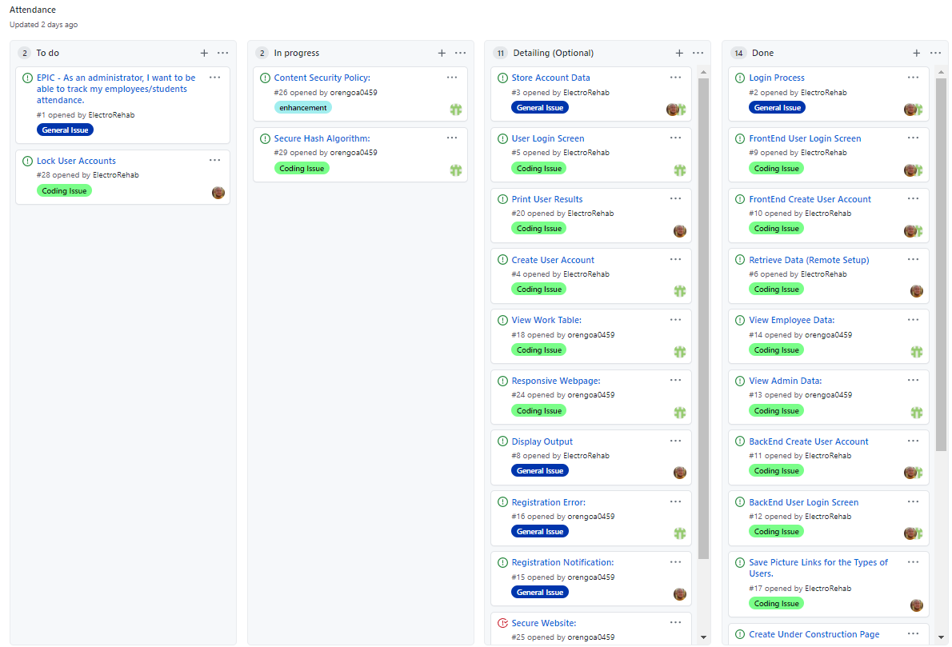
User Stories
Kanban Board

Slide 11
User Stories Cont.
# 1. EPIC - As an administrator, I want to be able to track my employees/student's attendance.

Slide 12
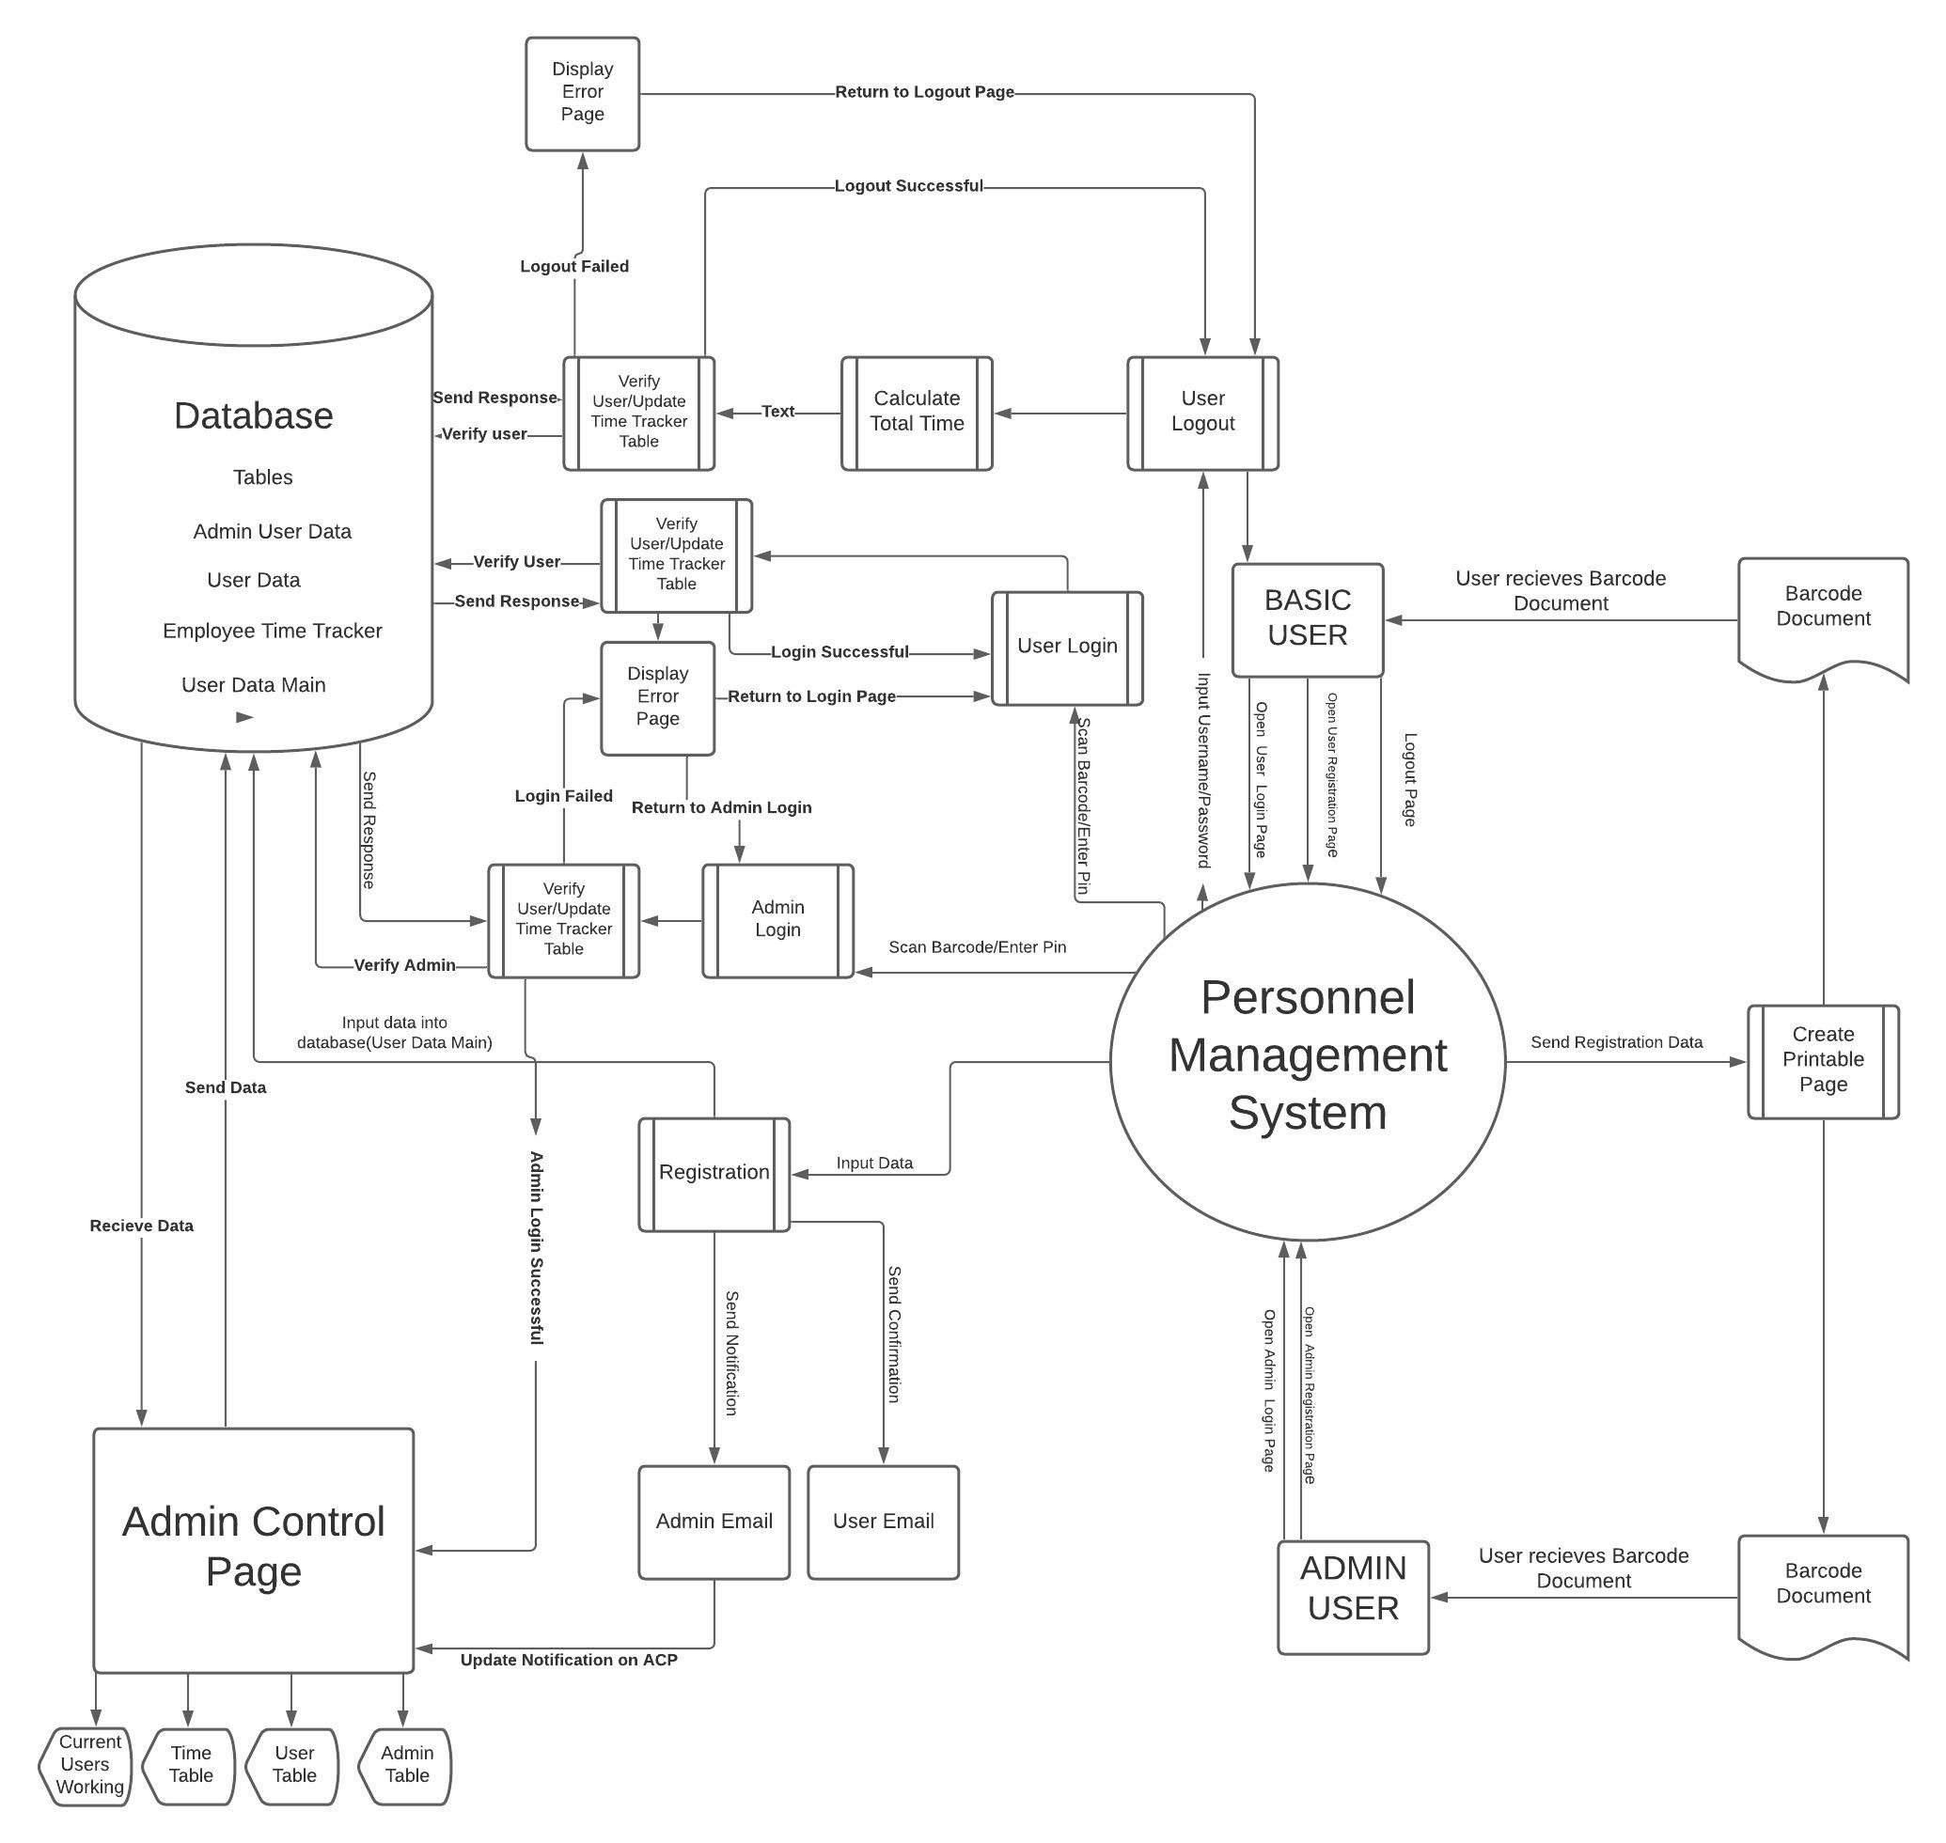
Context Diagram

Slide 13
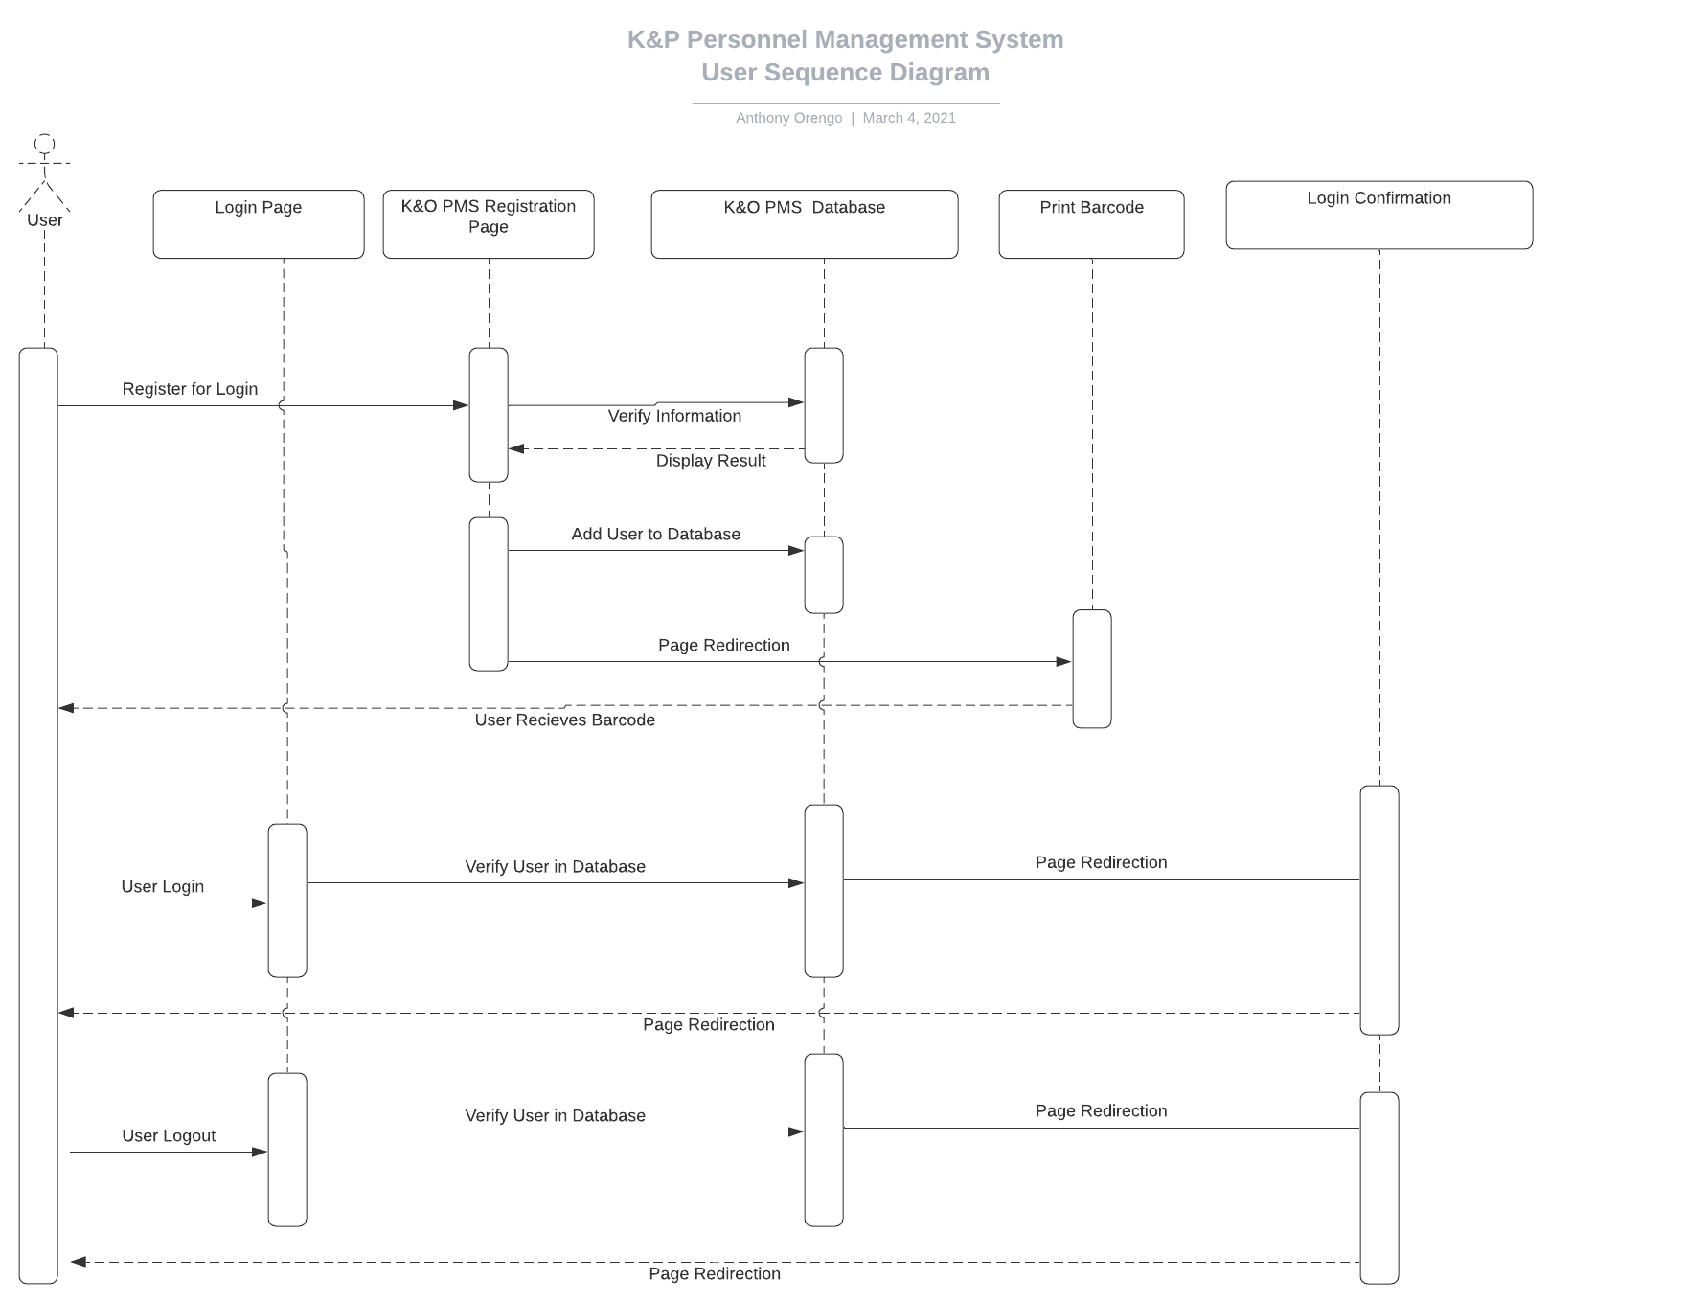
User Sequence Diagram

Slide 14
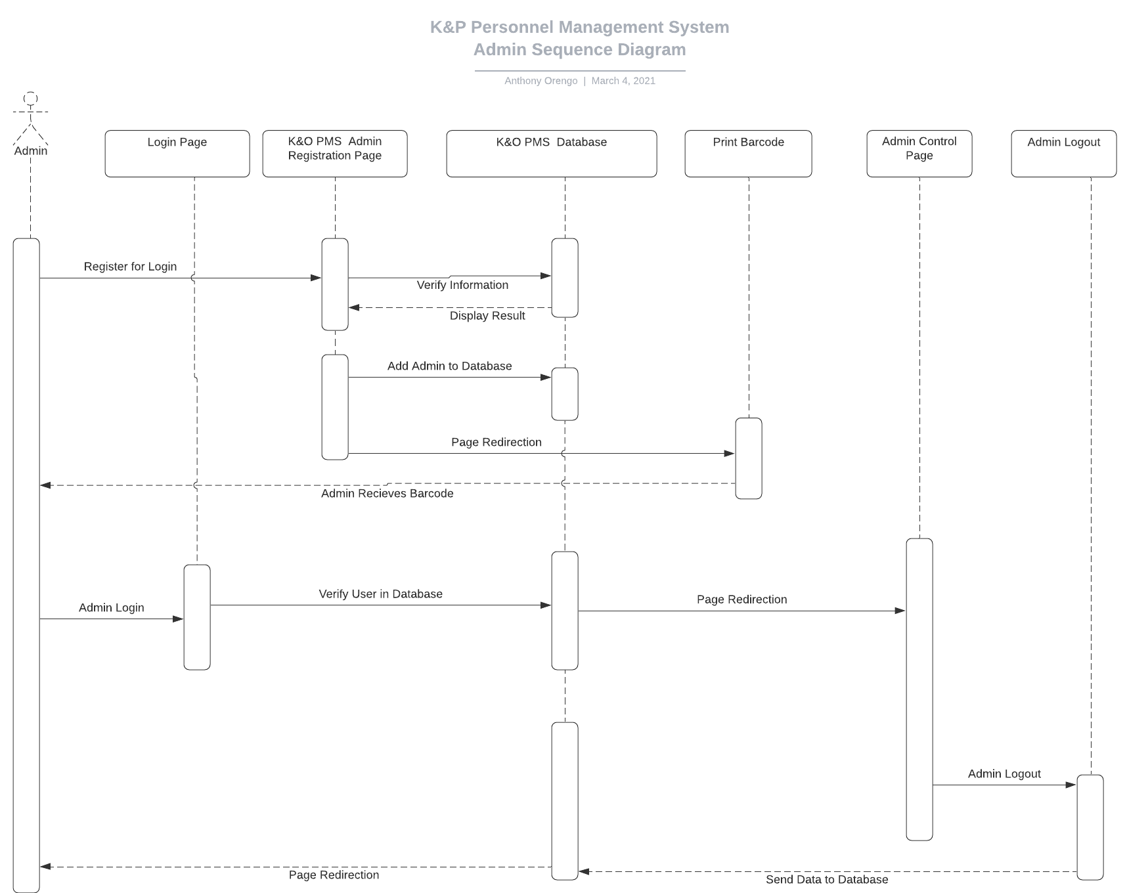
Admin Sequence Diagram

Slide 15

Application Security

Slide 16

Application Security
Security Methods
SQL----
HTTPS
Key Pair

Slide 17
Backend

Slide 18
Front End Security
Content Security Policy
XXS Injection
HTTPS(AWS)
DNSSEC signings

Slide 19

Live Demo

Slide 20
Questions?
Created by: Jon King, Anthony Orengo

